Slide 2
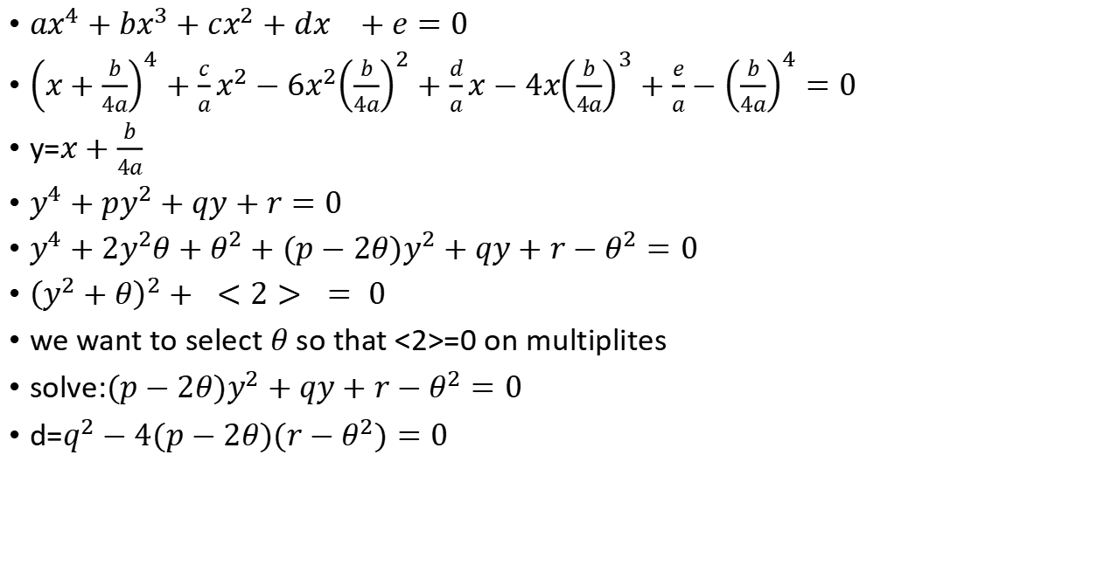
Ferrari method
$ax^{4}+bx^{3}+cx^{2}+dx^{}+e=0$
${\left(x+\frac{b}{4a}\right)}^{4}+\frac{c}{a}x^{2}−6x^{2}{\left(\frac{b}{4a}\right)}^{2}+\frac{d}{a}x−4x{\left(\frac{b}{4a}\right)}^{3}+\frac{e}{a}−{\left(\frac{b}{4a}\right)}^{4}=0$
y=$x+\frac{b}{4a}$
$y^{4}+{py}^{2}+qy+r=0$
$y^{4}+2y^{2}θ+θ^{2}+{(p−2θ)y}^{2}+qy+r−θ^{2}=0$
${\left(y^{2}+θ\right)}^{2}+ <2> = 0$
we want to select $θ$so that <2>=0 on multiplites
solve:${(p−2θ)y}^{2}+qy+r−θ^{2}=0$
d=$q^{2}−4(p−2θ)(r−θ^{2})=0$

